Slide 1
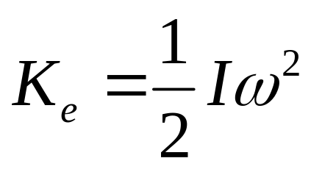
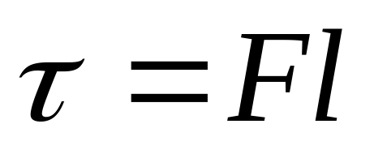
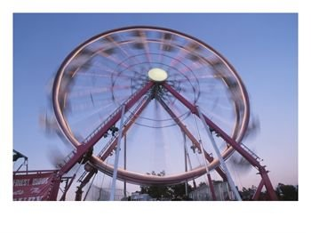
Rotation
Physics 131
Lecture 15
Review of rotational motion
Kinetic energy in rotational motion
Moment of inertia I
Torque τ
Conservation of Torque
All found in Young and Freedman, University Physics, chapter 9, sections 1 to 4 and chapter 10 section 1
Notes:
Today we’re going to move away from linear mechanics to rotational mechanics. First I’m going to quickly go over some things that we learnt in Mech I wrt rotational motion…things like angular displacement, velocity and acceleration of extended objects. Then I want to move onto kinetic energy in rotational motion, a quantity called moment of inertia and another called torque.
Here’s a list of what you need to know from this lecture. You have this information on the handout I have given you. The handout also includes the text book references.

Slide 2
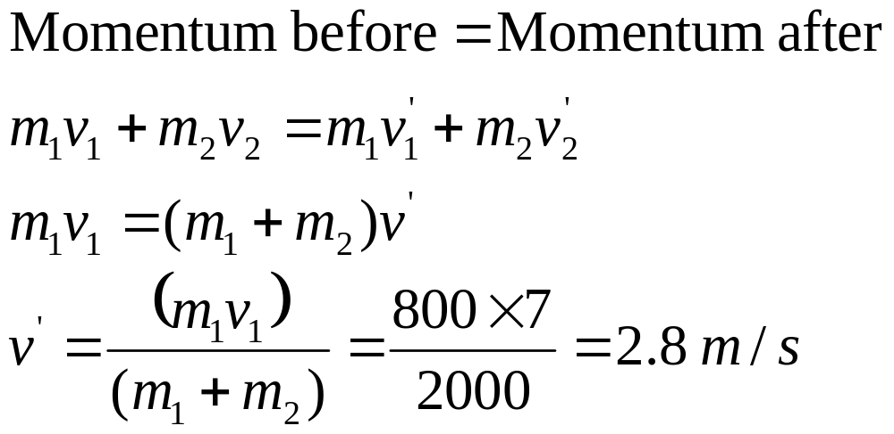
Review Conservation of momentum
An 800 kg car on a track moving at 7 m/s hits another 1200 kg stationary car and they stick together. What is the final velocity of both cars?
Notes:
Last lecture we extended our studies on linear momentum. We looked at the Conservation of momentum in Elastic Collisions, Conservation of momentum in Inelastic Collisions and saw what Centre of mass is and how it shows us that we can represent an extended body as a particle.
Who remembers in which case momentum is conserved ? (all)
Who remembers in which case kinetic energy is conserved ? (elastic only)
How do we define centre of mass (mass weighted average position of particles in a system)

Slide 3


Two cars of equal mass and velocity crash into each other. The result is a perfectly inelastic collision with final velocity of 0.
m _{A} v _{A}
m _{AB} -v _{AB}
Is momentum conserved?
Yes -p = +p
Is K conserved?
No Kinitial = 0final
Where has the K gone?
Heat, sound, crumpling

Slide 4
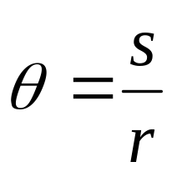
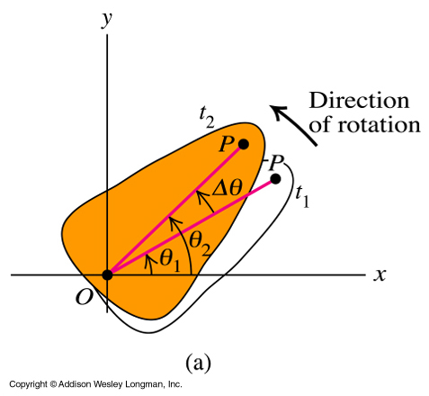
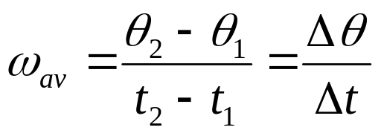
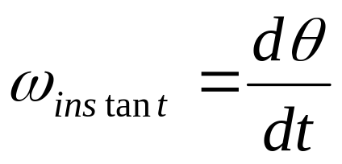
Angular velocity
Review
Rate of change of θ
= angular velocity = ω
Its SI units are rad/s
Notes:
So we have a coordinate to describe the position of a rotating body, now we can use this to describe the motion in terms of the rate of change of this coordinate. Just as for linear motion we looked at the rate of change of x (and y and z) and called this velocity, we can look at the rate of change of theta and call it angular velocity, omega. As the body rotates, the angular coordinate theta changes, just like the x coordinate changes in linear motion. The SI units of omega are rad/s. As for linear motion we need to define which way is the positive direction and stick to it.
The angular velocity, omega, is the same fro all points on the rigid body…see that wherever you draw your line from the axis of rotation to a point, it will move with the same delta theta as the body is rigid so all points rotate at the same rate.

Slide 5
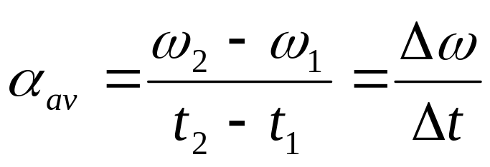
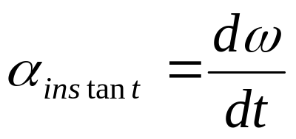
Angular acceleration
Review
Rate of change of ω
= angular acceleration =α
SI unit rad/s²
Notes:
Similarly for angular acceleration we have rate of change of omega = alpha. (rate of change of angular velocity = angular acceleration). SI unit is rad/s2.

Slide 6
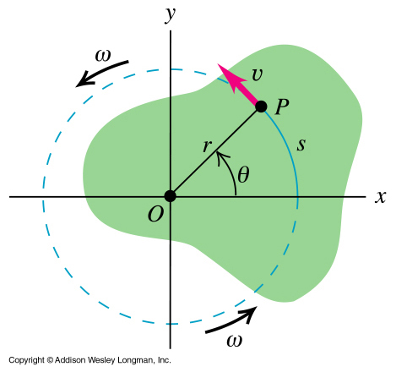
Equating linear and angular kinematics
Review
s = rθ when θ measured in radians.
v = rω
a = rα
Notes:
We may also want to know some linear properties of particles in the rigid body, such as the distance moved or the velocity v or linear accn a. How do we get these from the rotational quantities ?
Let’s tackle distance first. The distance s that point P moves is r theta when theta measured in radians. (s=r theta)
The speed v of point P equals r omega when omega in rad/s. (get this from s=r theta, ds/dt = v = r d theta/dt and d theta /dt = omega so v = r omega. The direction of this speed is at a tangent to the circular path.
The component of accn acting towards the centre of the circle of motion is a= omega squared r.

Slide 7
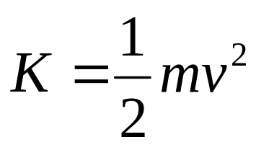
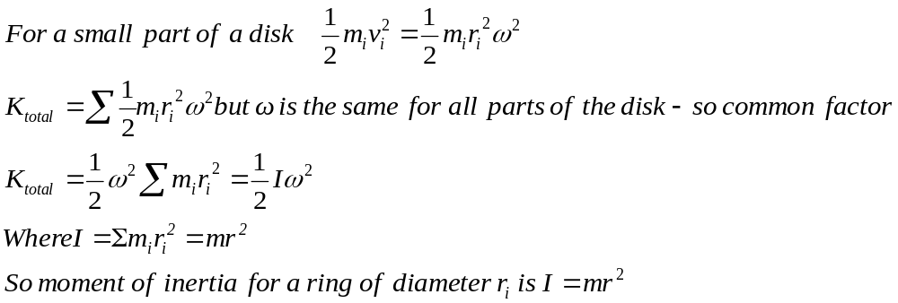
Kinetic energy in motion is
What about energy of motion in rotation for a disk?
m_{i}
r_{i}
So moment of inertia I depends on mass, but also distance from the axis.
Notes:
The kinetic energy (linear) is ½ mv²
Want the energy of motion of rotation… this depends on distance from the axis…
We can change the v to omega x r….
So can sum a whole heap of point masses- which make up the disk

Slide 8
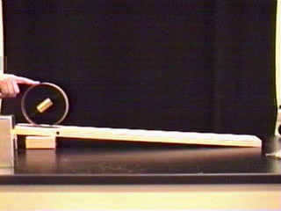
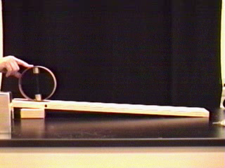
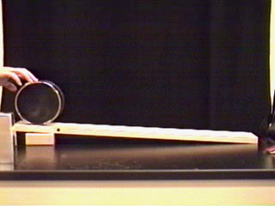
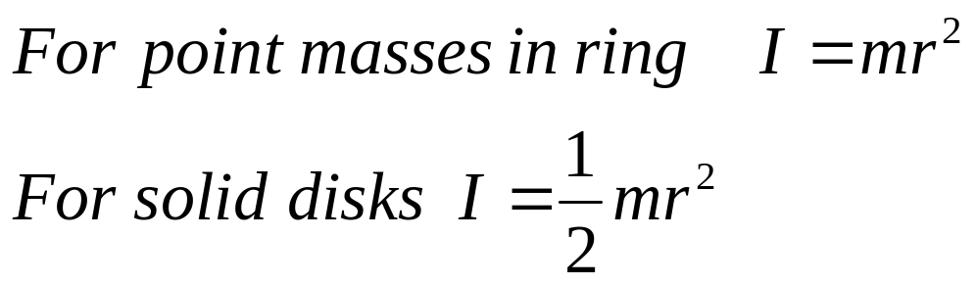
Moment of Inertia of Various Shapes

Slide 9
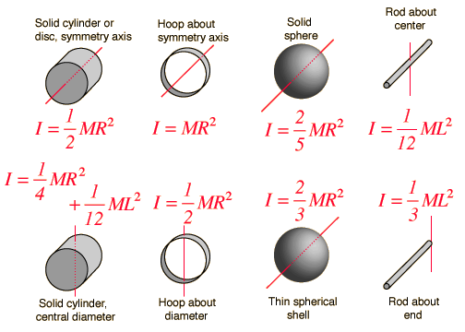
Common moments of inertia I

Slide 10
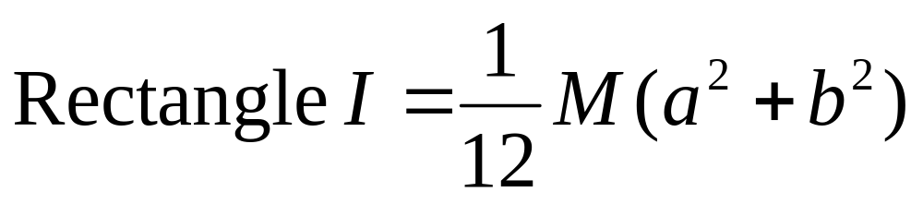
Moment of Inertia of shapes

Slide 11
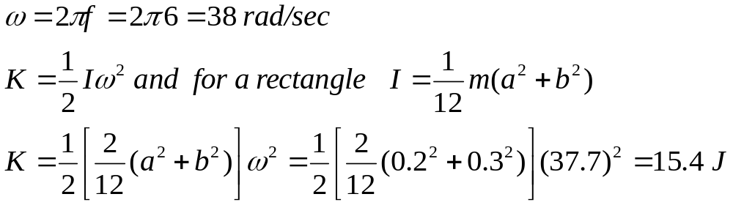
Find the Kinetic energy of a block of wood of mass 2 kg and one side 0.3m and width 0.2 m rotating 6 times/sec.

Slide 12
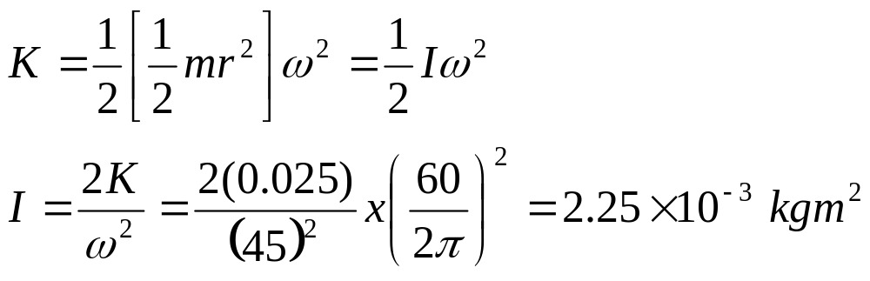
Example: Moment of Inertia
An antique phonograph turntable has a kinetic energy of 0.0250 J when turning at 45.0 rev/min. What is the moment of inertia of the turntable about the rotation axis.

Slide 13
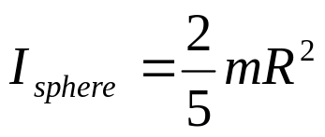
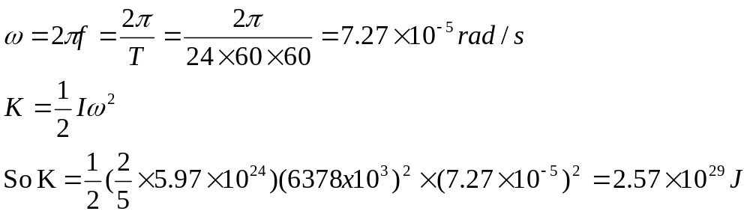
K of Earth rotating
Mass 5.97 x10²⁴ kg.
Period 24 hours
r = 6378 x10³ m

Slide 14

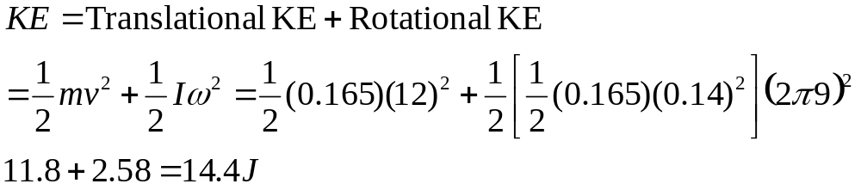
Kinetic energy of flying frizbee
A 165 g frisbee of radius 14 cm is thrown at 12 m/s spinning at 9 rev/sec. What is it’s total KE- assuming shaped like a disk.

Slide 15
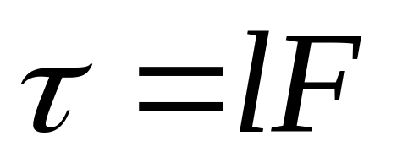
The angular equivalence of force is Torque
The quantitative measure of the tendency of a force to cause or change the rotational motion of a body is called torque.
It is the product of the magnitude of the force times the perpendicular distance of the line of action of the force to the axis of rotation.
Notes:
We’ve talked about rotational motion and the energy in rotating bodies, what about what makes them rotate. In linear motion we had a force that made things accelerate. What is it that makes a rigid object rotate about an axis ? Well it is a force but we can’t leave it at that. It depends where the force is applied to the body, ie how far from the axis of rotation the force is applied. The quantitative measure of the tendency of a force to cause or change the rotational motion of a body is called torque.
It is the product of the magnitude of the force times the perpendicular distance of the line of action of the force to the axis of rotation. Where line of action of the force is the line along which the vector lies.SEE DIAG on next slide

Slide 16
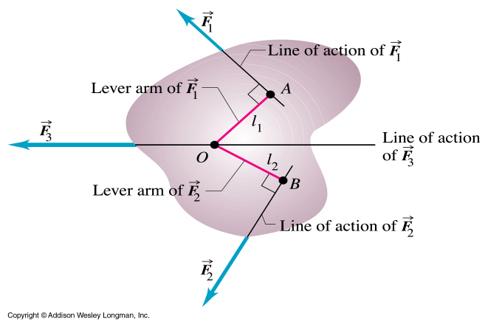
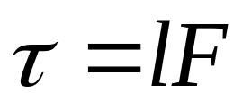
Torque
Notes:
This diagram will help to see what’s going on. We have a rigid body rotating about O. Force F1 acts at a certain place on the rigid body. We find its torque, or its ability to rotate the body, by combining its magnitude with the perpendicular distance of its line of action from O. See here what we mean by the line of action…..got the force acting in a direction, and need to draw from it to O at a right angle. Can do this if extend the arrow representing the force to a place where this is possible as shown. L1 is then the perpendicular distance interested in. This distance is sometimes called the lever arm. Here’s the equation for torque.
Torque is the rotational analogue to force. It is force times perpendicular distance.

Slide 17

Torque - Car

Slide 18
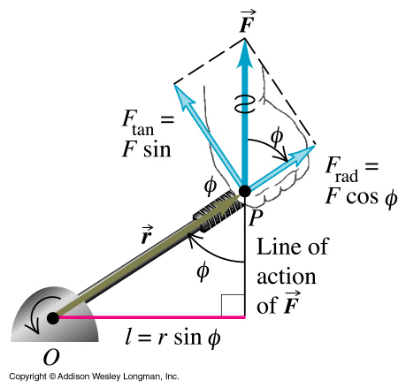
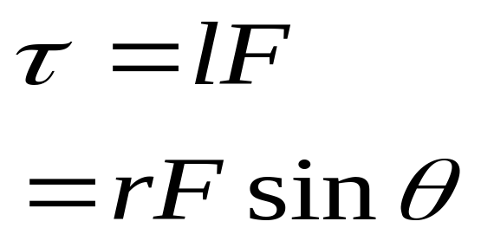
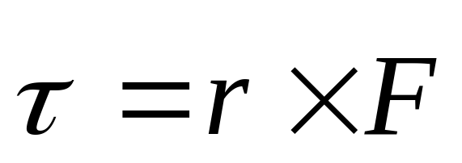
Torque
Notes:
We can be more mathematically specific by using the cross product..who remembers what the cross product is ? It is X x Y = XY sin theta where theta is the angle between X and Y.
In this diagram you can see that the perpendicular distance from the line of action of the force and the axis of rotation, the lever arm or l is r sin psi, where r is the position of the action of the force (ie point at which it acts on the body relative to the axis of rotation) and psi is the angle between the vector r and the force F (point right hand fingers along r and curl around to F as its r cross F…..the angle between r and the line of action is the same). So get torque = r sin psi times F = r cross F. This is how torque is sometimes written. Where psi is angle between line of action of F and position vector r of the position where force applied.
Basically when you have two vectors that want to combine you can either combine one with the component of the other one parallel to the first (dot product, cos psi) or with the perpendicular component (cross product, sin psi)
I don’t like this definition as it can be difficult to work out what the angle theta should be. I prefer to draw a diagram of what’s going on and then can see what the l is and how to calculate it..so I like to work from first principles rather than rely on an equation like this as it is easy to make mistakes without realising it.

Slide 19
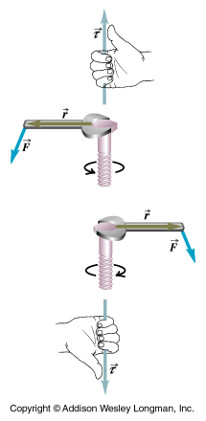
Torque is a vector.
Direction is along the axis given by the right hand rule
Notes:
The direction of torque follows the right hand rule.

Slide 20
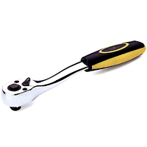
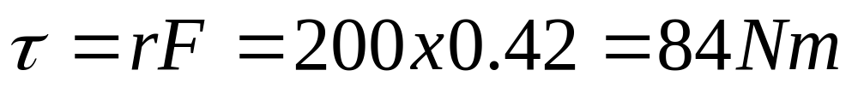
Torque
A socket wrench is being used to undo a difficult nut. If all the force is applied to the middle of the handle and the middle of the handle is 42 cm away from the bolt, and 200 N is applied to the wrench, how much torque is exerted on the nut?
If the distance to the centre of the handle is doubled to 84 cm, and the same force is applied, how does this affect the torque?

Slide 21
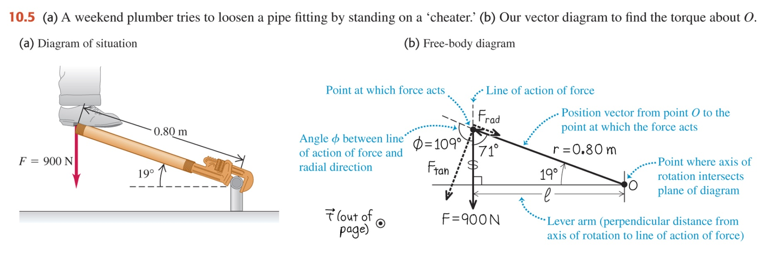
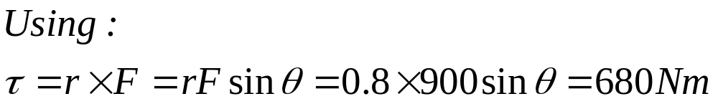
Example 10.1 Applying a Torque
A weekend plumber unable to loosen a pipe fitting, slips a piece of scrap pipe over his wrench handle. He then applies his full weight of 900 N to the end of the pipe by standing on it. The distance from the centre of the fitting to the point where the weight acts is 0.8 m, and the wrench handle and pipe make an angle of 19⁰ with the horizontal. Find the magnitude and direction of the torque he applies about the centre of the pipe fitting
Notes:
Let’s do an example.
A plumber unable to loosen a pipe fitting, slips a piece of scrap pipe over his wrench handle. He then applies his full weight of 900 N to the end of the pipe by standing on it. The distance from the centre of the fitting to the point where the weight acts is 0.8 m, and the wrench handle and pipe make an angle of 19⁰ with the horizontal. Find the magnitude and direction of the torque he applies about the centre of the pipe fitting.
SEE PHOTOCOPY

Slide 22
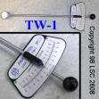
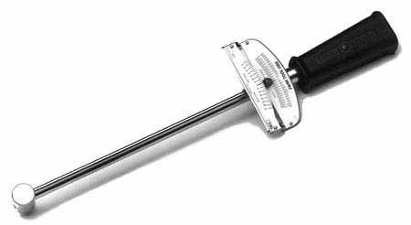
Uses- Torque wrench- a spanner that measures torque

Slide 23
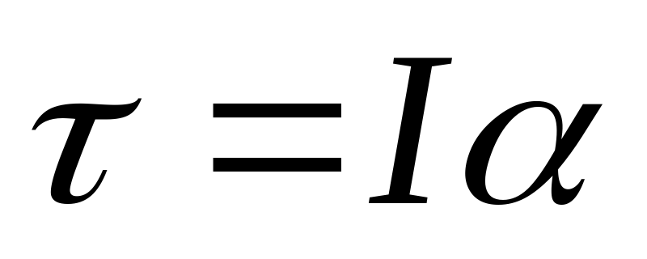
Torque, momentum and acceleration in angular terms
Rotational analogue of Newtons second law F=ma

Slide 24
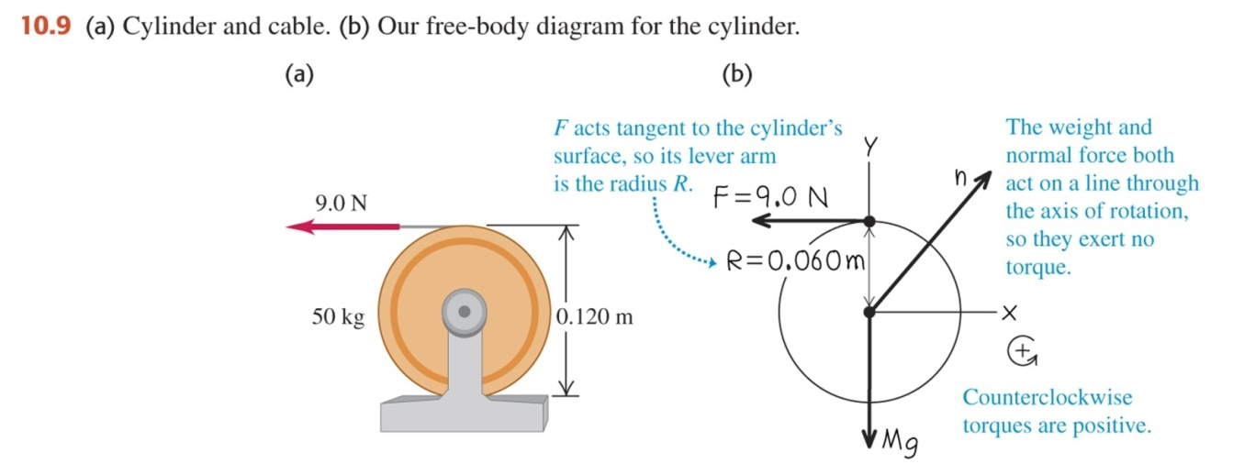
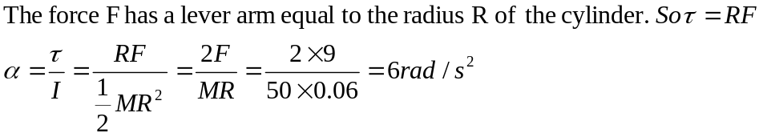

Example 10.2 An unwinding cable
A cable is wrapped several times around a uniform solid cylinder that can rotate about the axis. The cylinder has diameter 0.120 m and mass 50 kg. The cable is pulled with a force of 9.0 N. Assuming that the cable unwinds without stretching or slipping, what is its acceleration?
What is the tangential acceleration?

Slide 25
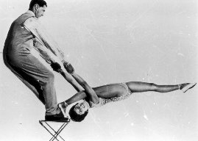
Newtons first law – no change if not net force. Rotational analogue, no change to rotational velocity if Στ=0
For Balance
τ Clockwise  = τ Anticlockwise 

Slide 26
Torque- in See Saw = a Balance
l₁
l₂
m₁
m₂
lever arm of F₁
lever arm of F₂
fulcrum
For Balance
τ Clockwise  = τ Anticlockwise 
l₂F₂= l₁F

Slide 27
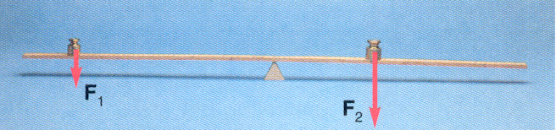
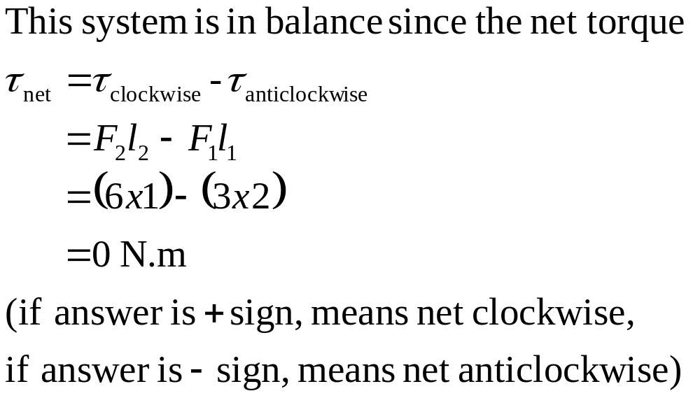
Torque and Balance – is this system in balance?
fulcrum
l₁=2m
=3 N
l₂ =1 m
=6 N

Slide 28
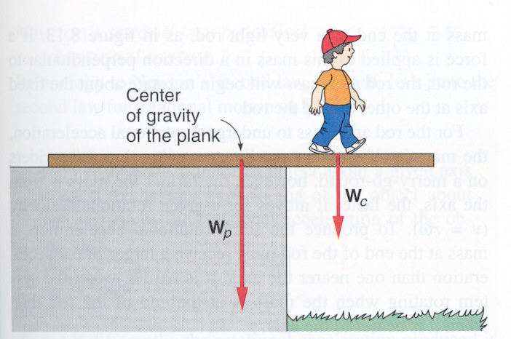
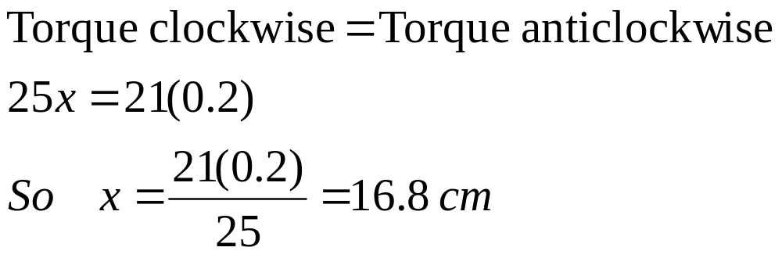
Example- Balance of Torque
How far can the child walk past the edge without tipping over the plank ?
25 kg
21 kg
20 cm

Slide 29
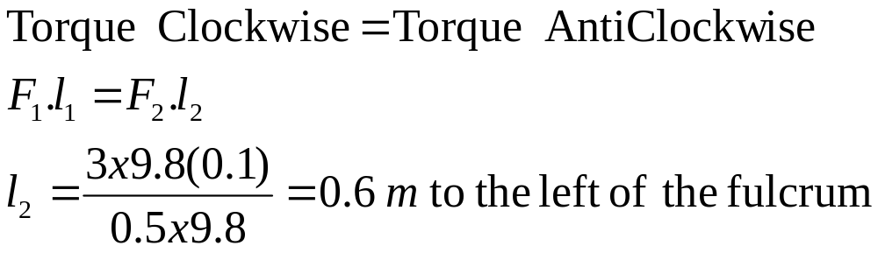
Example- Torque Balance
500 g
3 kg
?
10 cm
In the above balance, where must the 500 g
weight be placed in order to achieve balance ?

Slide 30
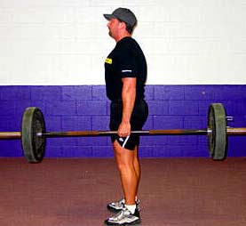
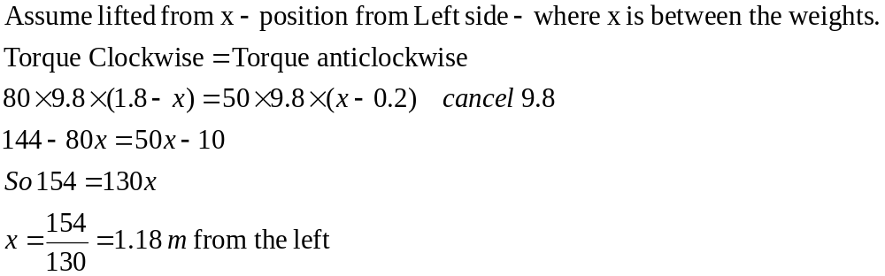
Example: Fulcrum position
A strong man wants to lift barbells. If the length of the bar is 2.0 m long and 50 kg is placed 0.20 m from the left end and 80 kg is placed 0.20 from the right end, where should the bar be lifted from to keep the bar level?

Slide 31
